Slide 1
Climate zones and forecasting in Nepal
MINSPIRE 2026 CAPSTONE
What 39 years of daily data can and can't tell us
TEAM CAT-MAN-DU
1

Slide 2
Three questions
THE PROBLEM
1
2
3
Can data alone group Nepal's districts into climate zones?
How well can we forecast monthly temperature and rainfall, and is it harder in some zones?
How far can we trust the data we are using?
2 / 17

Slide 3
62 districts, 39 years, one big caveat
THE DATA
62
39
883,128
0
districts
years, 1981 to 2019
missing values
daily rows
Source: NASA POWER via Kaggle. This is modelled data, not station readings, so changes in how it was produced can create artificial jumps.
3 / 17

Slide 4
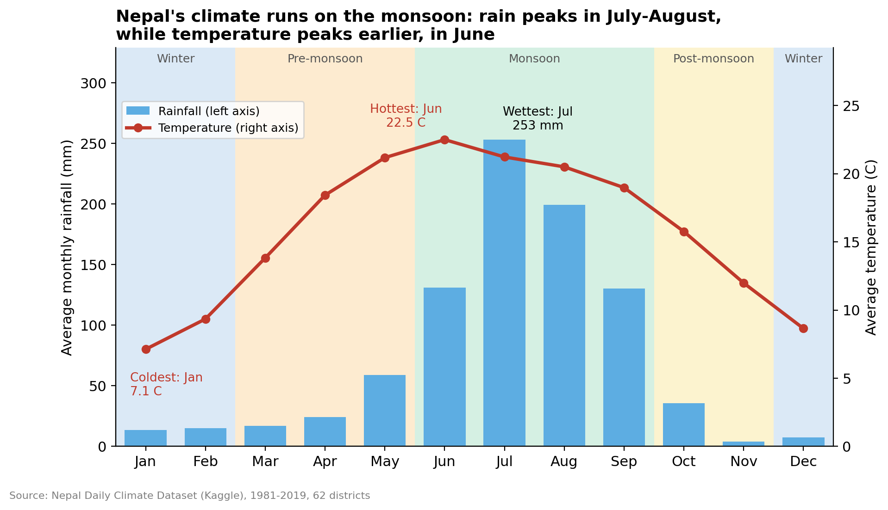
The monsoon runs the year
EXPLORING THE DATA
About 80% of rain falls June to September; July is the wettest month, June the hottest.
4 / 17

Slide 5
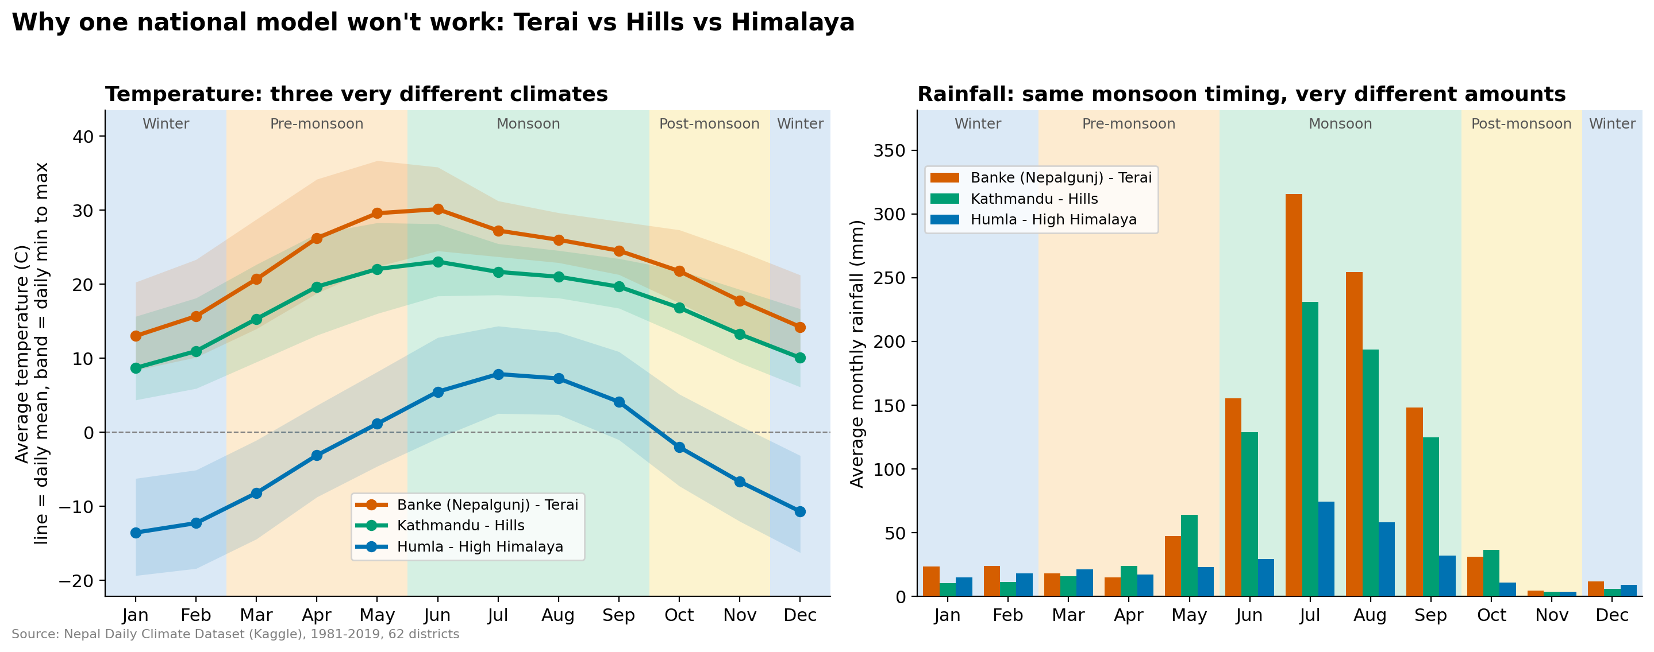
Nepal's regions are very different climates
EXPLORING THE DATA
Banke (Terai) about 22 °C, Kathmandu (hills) about 17 °C, Humla (Himalaya) below 0 °C. One national model would not work.
5 / 17

Slide 6
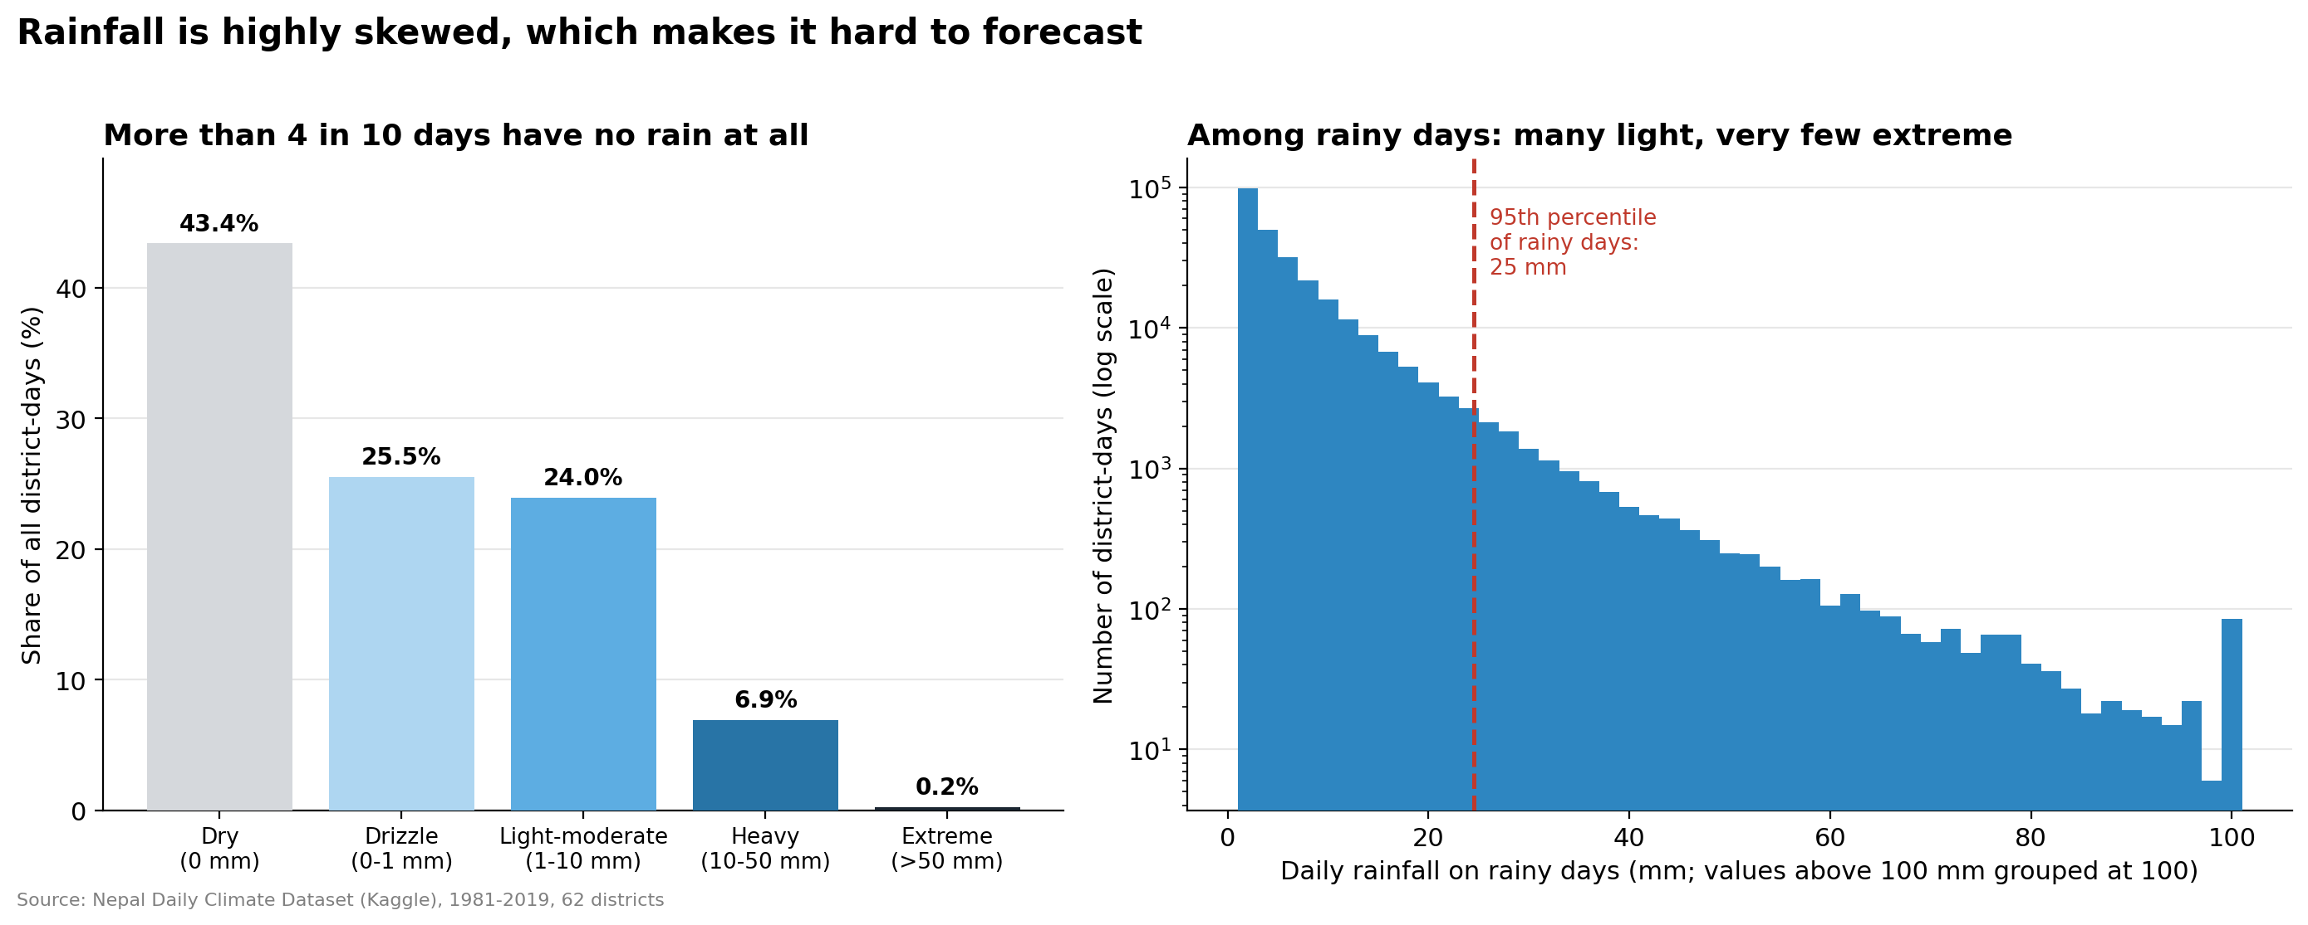
Rainfall is spiky: 43% of days are dry
EXPLORING THE DATA
Most rainy days are light and a few exceed 50 mm. There is no significant warming trend (+0.014 °C per decade, p = 0.80).
6 / 17

Slide 7
Find zones, forecast, then stress-test
METHOD
STEP 4
STEP 5
STEP 1
STEP 2
STEP 3
Forecast 2015 to 2019
Daily data
›
Four features
›
K-Means
›
›
Stress tests
62 districts
per district
3 climate zones
baselines vs SARIMA
districts, windows, methods
Features: mean temperature, annual rainfall, monsoon share, seasonal temperature swing. Models train only on earlier years and are tested on 2015 to 2019.
7 / 17

Slide 8
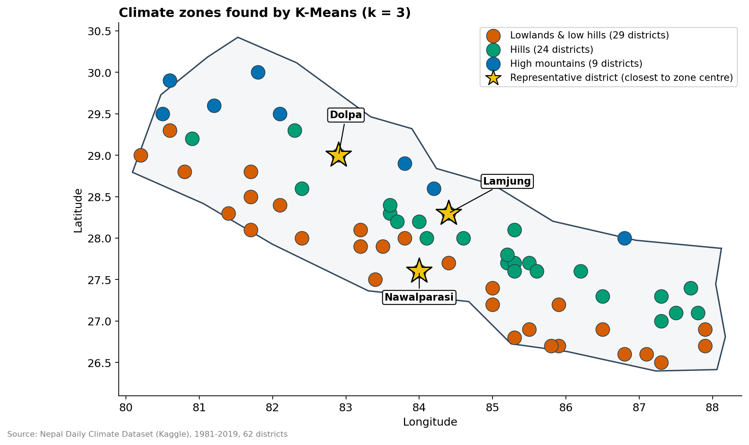
The data finds three climate zones
RESULTS: ZONES
29 districts
lowlands and low hills
24 districts
hills
9 districts
high mountains
8 / 17

Slide 9
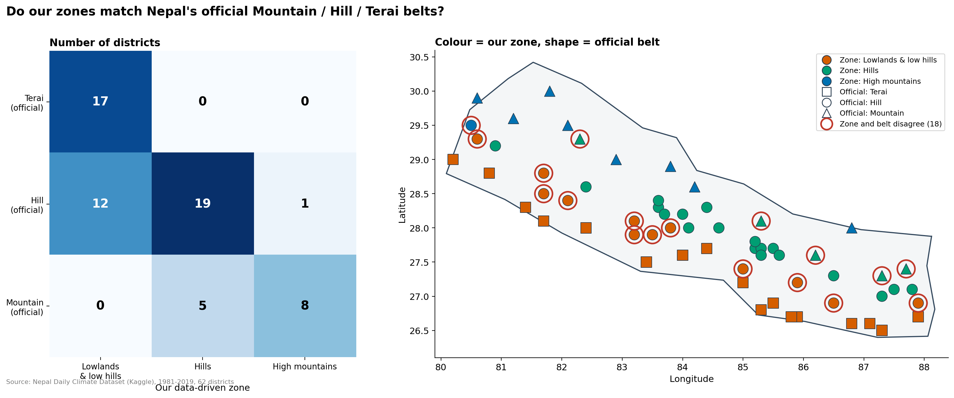
The zones follow the Terai, Hill and Mountain belts
RESULTS: ZONES
All 17 Terai districts land in the lowland zone and 71% of districts match overall. Disagreements sit at the hill/mountain edge.
9 / 17

Slide 10
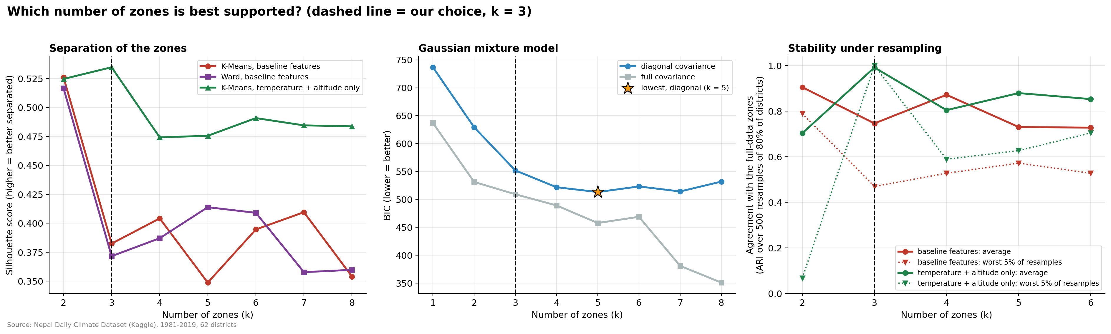
Temperature and altitude support exactly three zones
RESULTS: ZONES
With temperature and altitude only, k = 3 is the clear winner (silhouette 0.54, stability 0.99). With rainfall features, k = 2 scores higher.
10 / 17

Slide 11
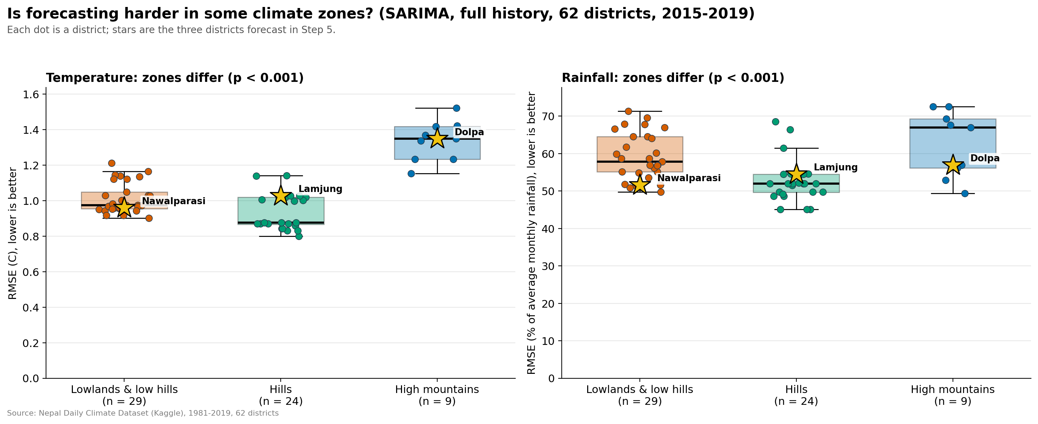
Forecasting is easiest in the hills
RESULTS: FORECASTING
SARIMA error for all 62 districts, 2015 to 2019. Temperature error is about 1 °C; rainfall error is about 50 to 65% of average monthly rainfall.
11 / 17

Slide 12
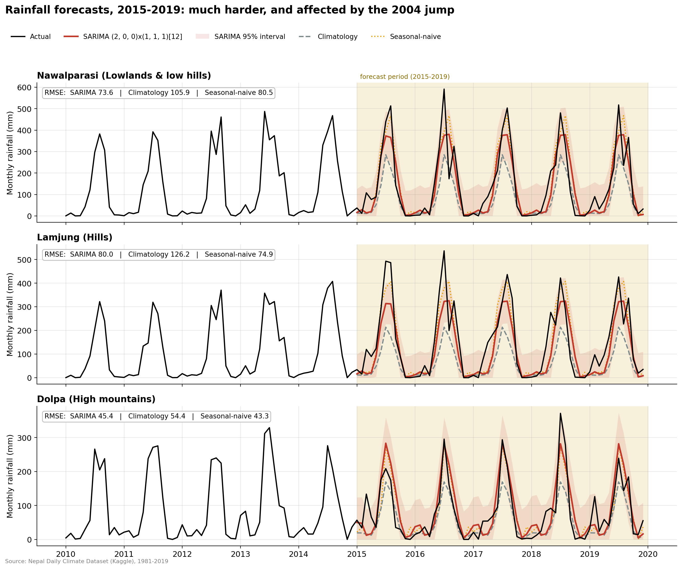
Rainfall is much harder than temperature
RESULTS: FORECASTING
SARIMA beats the baselines
in most districts
Temperature
mostly the seasonal cycle
Full-history monthly average
runs about 30% too low
12 / 17

Slide 13
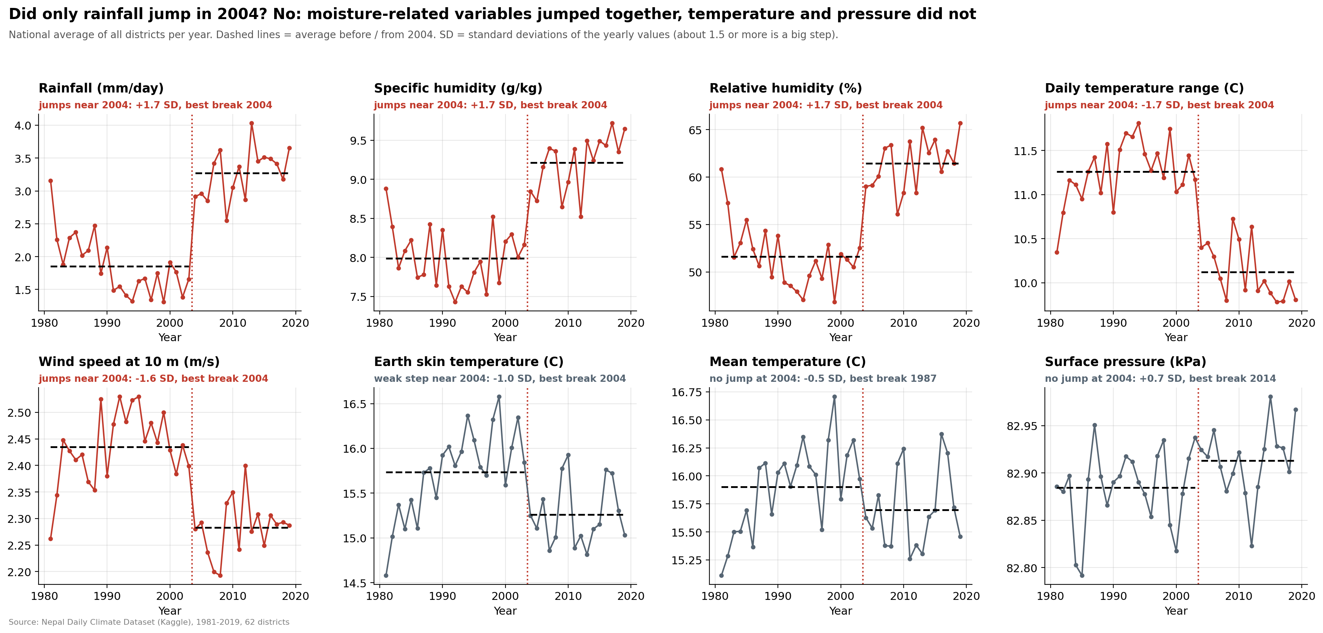
A hidden jump in 2004
FAILURE ANALYSIS
Seven moisture, wind and temperature-range variables jump together (Dec 2003 to May 2004), mean temperature and pressure do not. Most likely a data artifact, unproven.
13 / 17

Slide 14
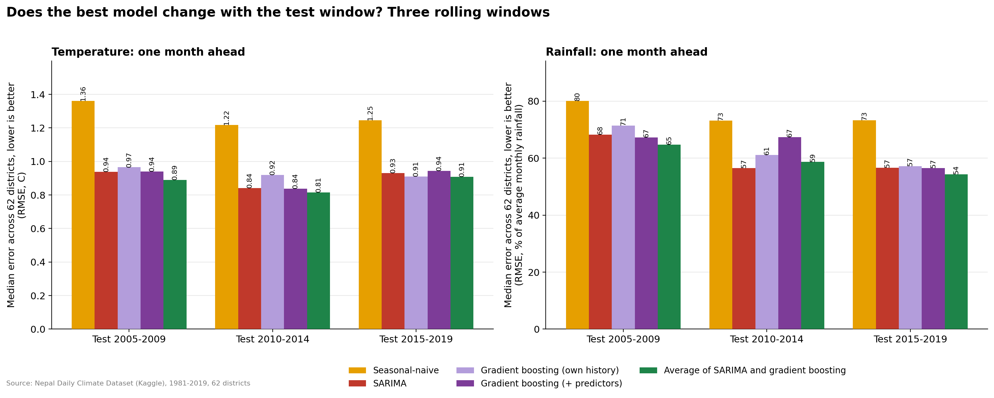
Fancier models gave only small gains
FAILURE ANALYSIS
Averaging SARIMA and gradient boosting was best in 5 of 6 tests, by about 2 to 5%. A log transform made rainfall worse.
14 / 17

Slide 15
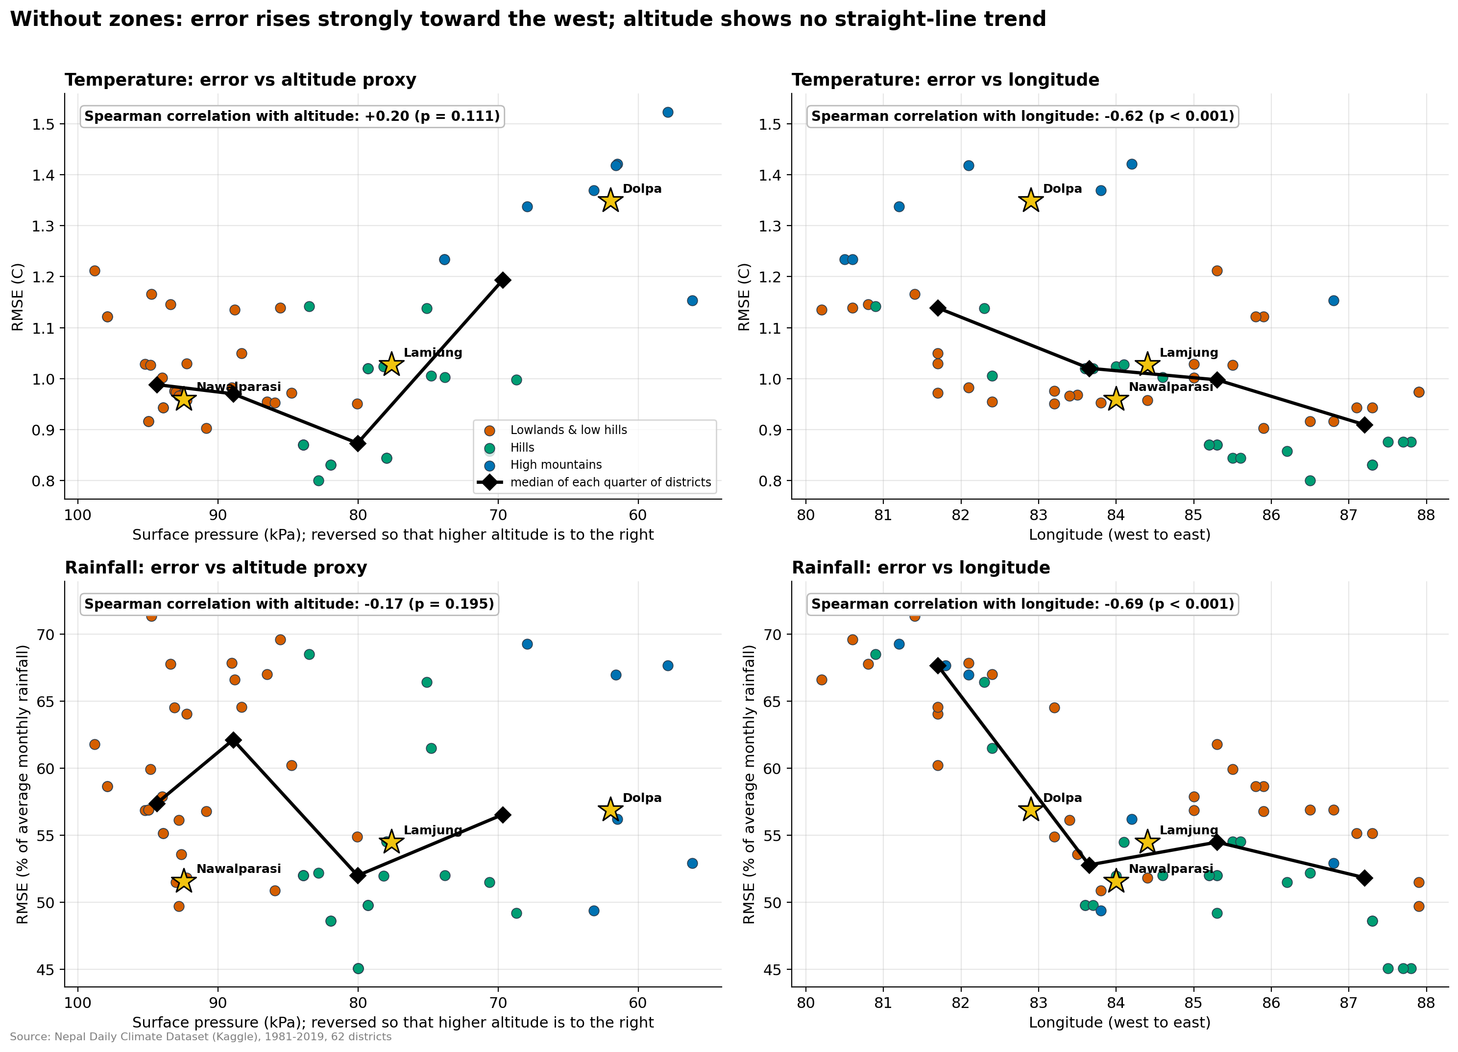
Forecast error rises toward the west
FAILURE ANALYSIS
-0.62 and -0.69
correlation with longitude (temperature, rainfall)
No straight-line altitude trend
temperature is U-shaped: hills easiest
Cause untested
weaker monsoon? modelled data?
15 / 17

Slide 16
Limitations and next steps
WHAT NEXT
Limitations
Next steps
Modelled data with a 2004 step
Mountain zone has only 7 to 9 districts
One main test window, 2015 to 2019
West-to-east cause not tested
Check 2004 against station records
Add elevation data
Separate western and eastern models
Test longer forecast horizons
16 / 17

Slide 17
CONCLUSIONS
1
Three climate zones along temperature and altitude
2
Temperature is easy to forecast, rainfall is hard, and the west is harder
3
Checking the data mattered as much as building models
Thank you. Questions?
17 / 17

